Slide 1


Smart Traffic Routing
Mepco Schlenk Engineering College (Autonomous)
Prabakaran K (9517202309085)
Sukil Raj M S (9517202309113)
Sanjay K N (9517202309101)
Department of Artificial Intelligence & Data Science
4 November 2025

Slide 2
OUTLINE
Introduction
Problem Description
Objectives
Outcomes
SDLC & SRS
UML Diagrams
Implementation
Risks & Testing
Evaluation Parameters / Metrics
Results
Conclusion
Department of Artificial Intelligence & Data Science
4 November 2025

Slide 3
INTRODUCTION
Urban areas face recurring congestion during peak periods
Most traffic control is reactive
Smart Traffic Automation explores a proactive approach: users reserve road usage slots on a simulated road graph.
The system computes occupancy-aware optimal routes (Dijkstra), calls a Python predictor for recommended speeds, and stores bookings in MongoDB.
Department of Artificial Intelligence & Data Science
4 November 2025

Slide 4
PROBLEM STATEMENT
Urban roads often face congestion due to uncoordinated vehicle flow.
Peak-hour traffic leads to delays, increased fuel consumption, and pollution.
Current systems do not offer pre-booking or optimal speed guidance to prevent traffic jams.
There's a lack of smart tools to simulate and plan city traffic using AI techniques.
Department of Artificial Intelligence & Data Science
4 November 2025

Slide 5
OBJECTIVES
To build a web-based system for booking road usage slots in advance.
To predict future traffic load using AI/ML models.
To recommend optimal speed for smooth vehicle movement.
To simulate a mini smart-city road network for demonstration purposes.
Department of Artificial Intelligence & Data Science
4 November 2025

Slide 6
EXPECTED OUTCOMES
Users can register, log in, and book route slots; bookings persist in DB
Backend computes an optimal path and a recommended speed for each booking
Admin can view all bookings, toggle road status, and export CSV reports
Performance expectations : Dijkstra + prediction ≤ 2000 ms on a 67-node graph; UI interactions < 2 s.
Department of Artificial Intelligence & Data Science
4 November 2025

Slide 7


SDG GOALS
Project reduces congestion
Improves city mobility
Smoother traffic reduces idling and emissions
Department of Artificial Intelligence & Data Science
4 November 2025

Slide 8
ITERATIVE DEVELOPMENT MODEL
Sprint 1: Authentication, graph seeding, basic booking UI
Sprint 2: Dijkstra integration, booking persistence, admin UI
Sprint 3: ML predictor integration, tests, polishing.
Department of Artificial Intelligence & Data Science
4 November 2025

Slide 9
SRS
Purpose: Define functionality and constraints for Smart Traffic Automation demo
Functional Requirements: Register, Login, Book Route, Compute Path, Predict Speed, Admin view, Export CSV
Non-Functional Requirements: Response time goals, JWT security, ML fallback for reliability
Interfaces: REST API endpoints (e.g., /api/auth/login, /api/bookings/book, /api/roads/all)
Data model: Collections: users, roads, bookings
Key fields: userEmail, path, slot, recommendedSpeed.
Department of Artificial Intelligence & Data Science
4 November 2025

Slide 10
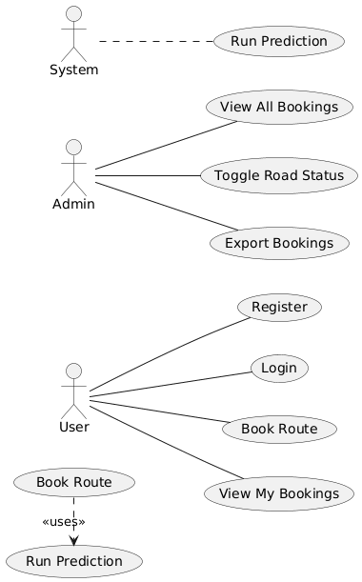
USE CASE DIAGRAM
>Shows actors and their high-level interactions with the system
4 November 2025

Slide 11
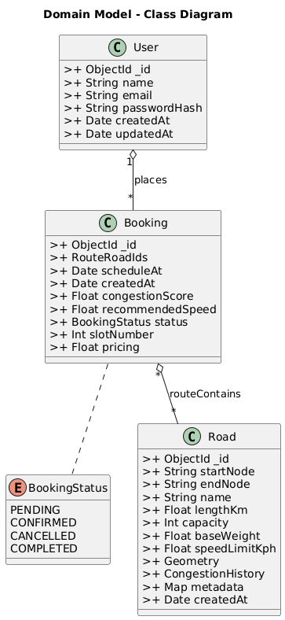
CLASS DIAGRAM
>Defines backend classes/models with visibility and relationships
4 November 2025

Slide 12
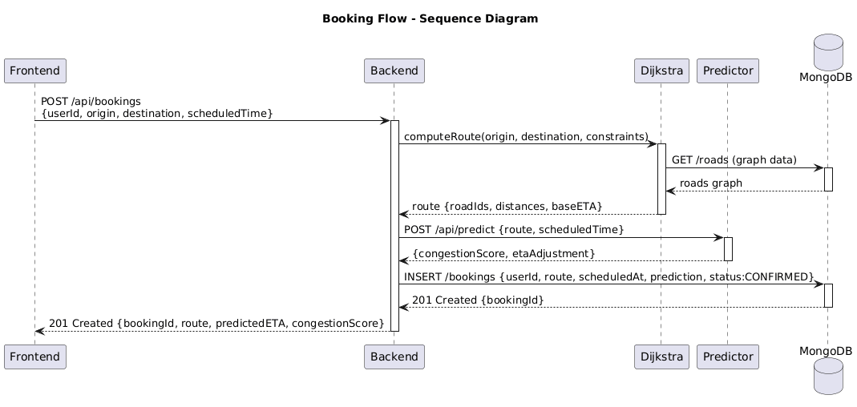
SEQUENCE DIAGRAM
>Time-ordered message flow for booking
4 November 2025

Slide 13
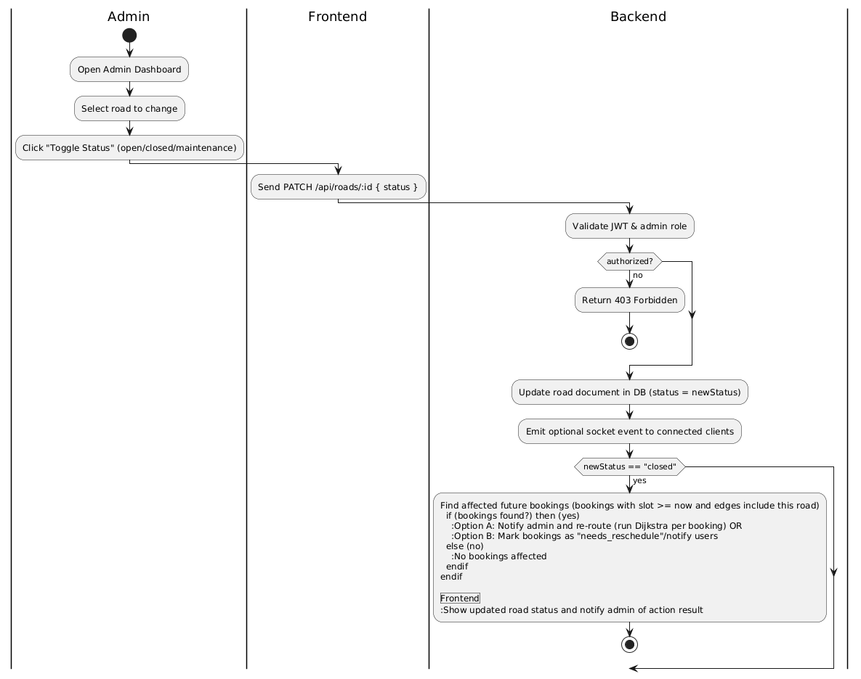
ACTIVITY DIAGRAM
>Workflow and decision points for booking
4 November 2025

Slide 14
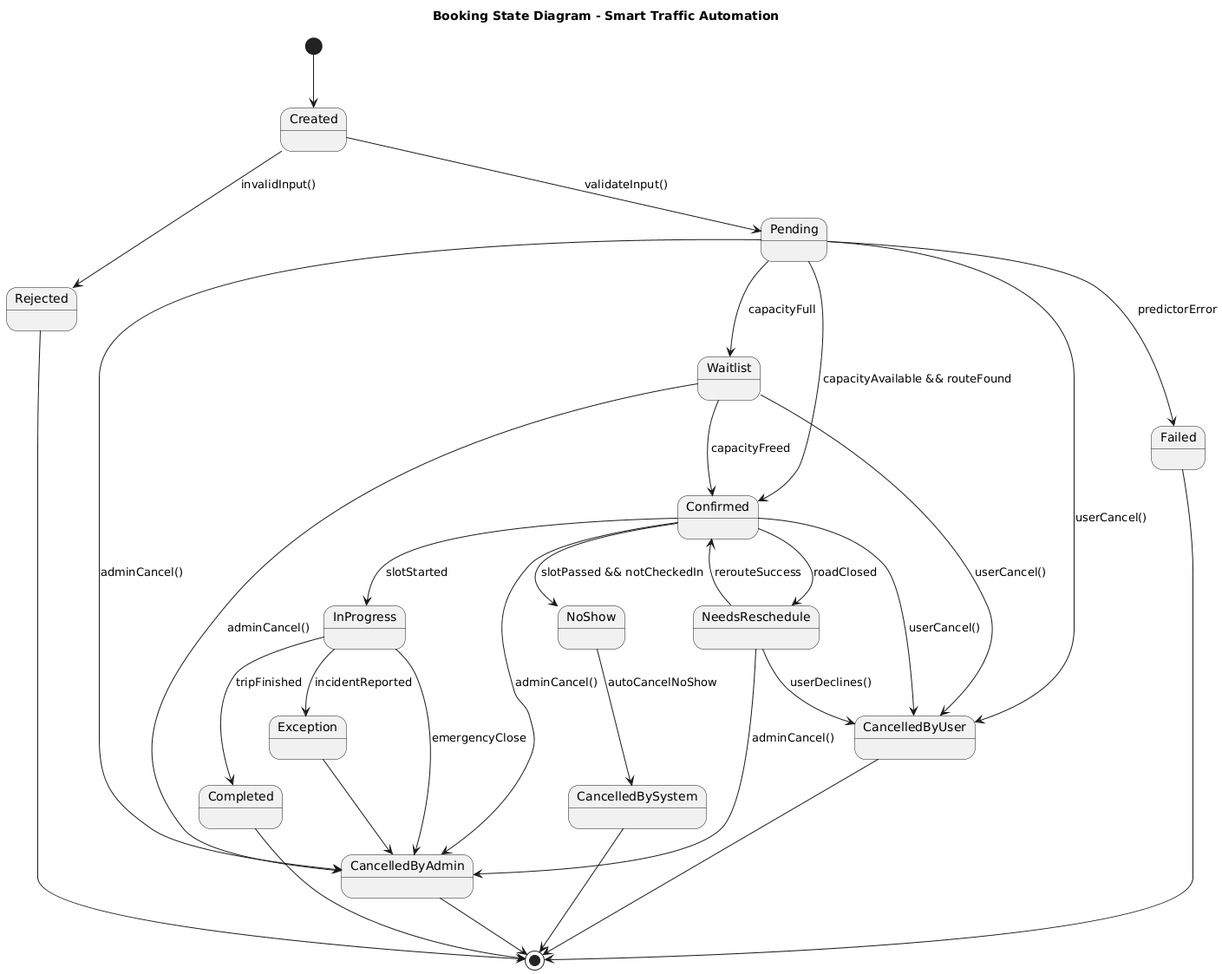
STATE DIAGRAM
>States and transitions of a booking
4 November 2025

Slide 15
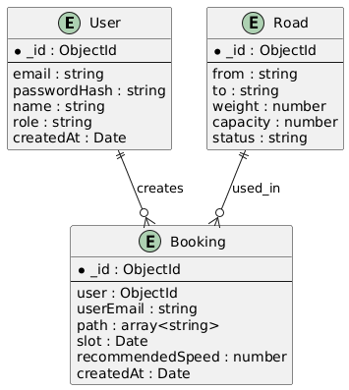
ER DIAGRAM
>Data entities and relationships plus primary data flows for booking creation and reporting.
4 November 2025

Slide 16
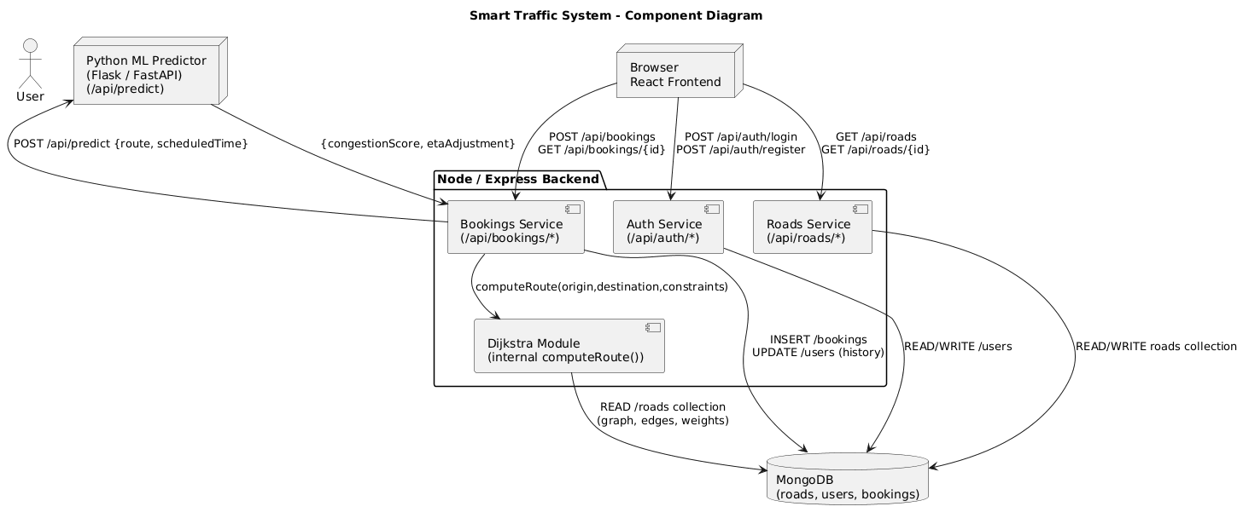
COMPONENT DIAGRAM(HLD)
>High-level components and their interfaces
4 November 2025

Slide 17
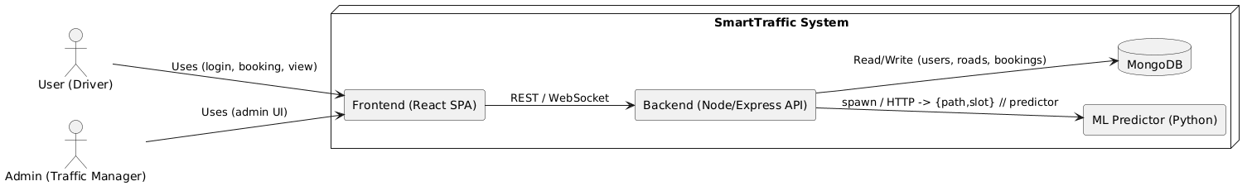
SYSTEM CONTEXT DIAGRAM(HLD)
Users and Admin interact with React SPA which calls REST API
API interacts with MongoDB and Python ML predictor
4 November 2025

Slide 18
IMPLEMENTATION
Data Collection: Road network seeded using a JSON graph generator (67 nodes, weighted edges with capacity and status fields)
Database Method: Used MongoDB with Mongoose ODM for schema validation and CRUD operations
Collections & Structure: Three collections — Users, Roads, Bookings: Each document stores flexible JSON (BSON) data with indexed fields
Queries Implemented: Optimized CRUD and aggregation pipelines for login validation, booking creation, slot occupancy, and admin exports
Data Integrity & Security: Passwords hashed with bcrypt, JWT-based auth for API access, and referential consistency maintained via user–booking references.
Department of Artificial Intelligence & Data Science
4 November 2025

Slide 19
OVERVIEW
Tech Stack: React, Node.js + Express (Backend API), MongoDB (Database), Python (ML Predictor)
Architecture: Modular 3-tier design — Frontend → REST API → Database & ML Service ensures scalability and easy debugging
Development Ideology: Followed Iterative Agile model — core booking module first, followed by ML, admin, and performance enhancements
Data Flow: User request → Node API → Dijkstra routing → Python predictor → MongoDB save → Response with route & speed.
Department of Artificial Intelligence & Data Science
4 November 2025

Slide 20
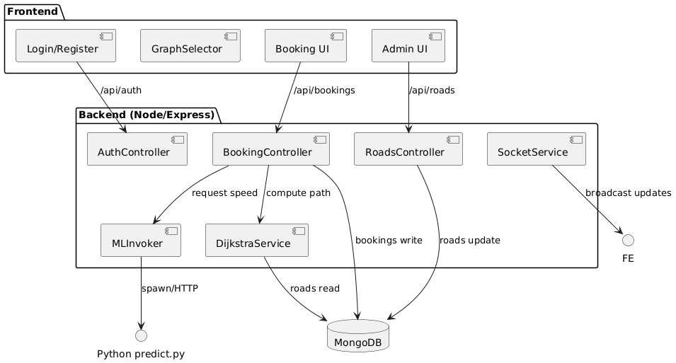
BLOCK DIAGRAM
4 November 2025

Slide 21
RISKS
Security — user data exposure (weak hashing / leaked JWT).
Usability — confusing graph selector or inconsistent UI.
Performance — slow Dijkstra or blocking ML predictor; UI lag on low-end devices.
Requirement — scope creep or unclear ML expectations.
Schedule — frontend/backend integration delays (CORS, API mismatch).
Department of Artificial Intelligence & Data Science
4 November 2025

Slide 22
Risk | Likelihood | Impact | Mitigation strategy
Security — user credential leak or weak hashing | Medium | High | Use bcrypt with salt, store JWT secret in env, validate inputs, run simple security checks before demo.
Usability — confusing graph selector / UI | Medium | Medium | Improve visual affordances, provide keyboard fallback, add small help tooltip and onboarding text.
Performance — ML blocking backend or slow Dijkstra | Medium | High | Use heuristic fallback when ML fails; optimize Dijkstra; limit graph size for demo; profile and optimize critical code paths.
Requirement changes — scope creep | Medium | Medium | Freeze MVP feature list before each sprint; document change requests and impact on schedule.
Schedule — integration / build errors | High | Medium | Prepare seed data, use environment checklist, do early integration tests, keep simple hardcoded fallbacks for demo.

Slide 23
TESTING
Verify core flows: register, login, book route, admin operations
Validate UI usability and graph interactions
Ensure bookings persist with correct path, slot and recommended speed
Approach: Unit tests, Integration tests, Manual UI tests
Confirm ML fallback works so booking still succeeds on predictor failure
4 November 2025

Slide 24
Feature tested | Test description | Expected result | Actual result
User registration | Submit valid name, email, password via /register | New user created, JWT returned, redirected to booking page | Pass
Login with invalid credentials | Wrong password attempt | HTTP 401, error message, no token saved | Pass
Booking creation (happy path) | Select source & destination, optional slot, click calculate | POST /api/bookings/book returns booking with path and recommendedSpeed; DB record created | Pass
Admin view all bookings | Login as admin, open dashboard | Admin sees all bookings including new ones; export works | Pass
Toggle road status (admin) | Admin sets road to closed then open | Road status updated in DB and UI; Dijkstra excludes closed edges | Pass
UI graph interaction | Click nodes to select source and destination (keyboard fallback) | Node selection updates UI and hidden form values; works across browsers | Pass

Slide 25
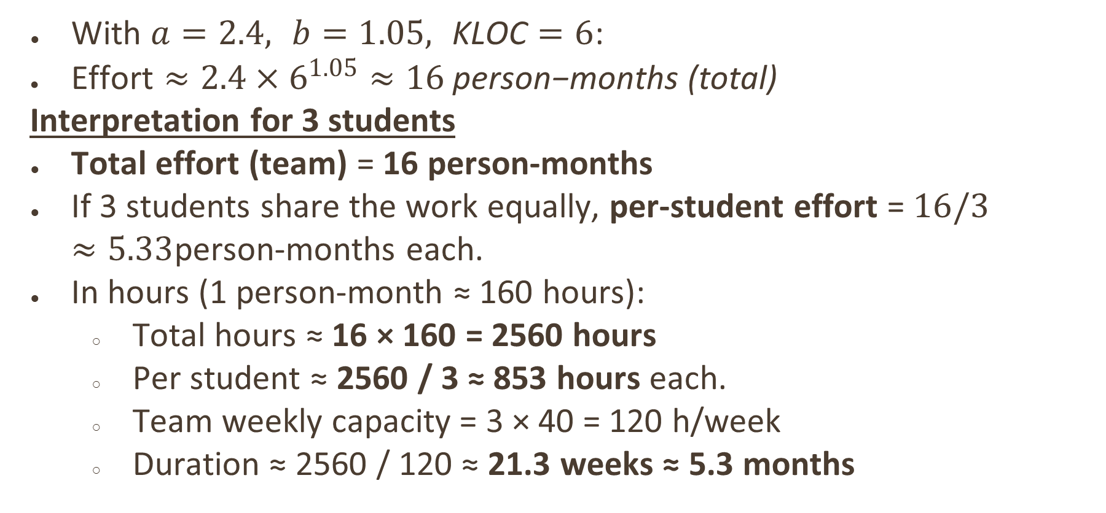
COCOMO ESTIMATION
With $a=2.4, b=1.05, \text{KLOC}=6$:
$\text{Effort}≈2.4×6^{1.05}≈16 \text{person}\text{−}\text{months}\text{ (}\text{total}\text{)}$
Interpretation for 3 students
Total effort (team) = 16 person-months
If 3 students share the work equally, per-student effort = $16/3≈5.33$person-months each.
In hours (1 person-month ≈ 160 hours):
Total hours ≈ 16 × 160 = 2560 hours
Per student ≈ 2560 / 3 ≈ 853 hours each.
Team weekly capacity = 3 × 40 = 120 h/week
Duration ≈ 2560 / 120 ≈ 21.3 weeks ≈ 5.3 months
4 November 2025

Slide 26
FUNCTIONAL POINTS
Count summary:
EI (inputs) = 4 (register, login, book, update road)
EO (outputs) = 3 (booking result, road list, CSV)
ILF (files) = 3 (users, roads, bookings)
UFP estimate: ~12; adjusted FP ≈ 28
Interpretation: FP gives a function-based size measure useful to plan testing and documentation scope
Department of Artificial Intelligence & Data Science
4 November 2025

Slide 27
RESULTS

Slide 28
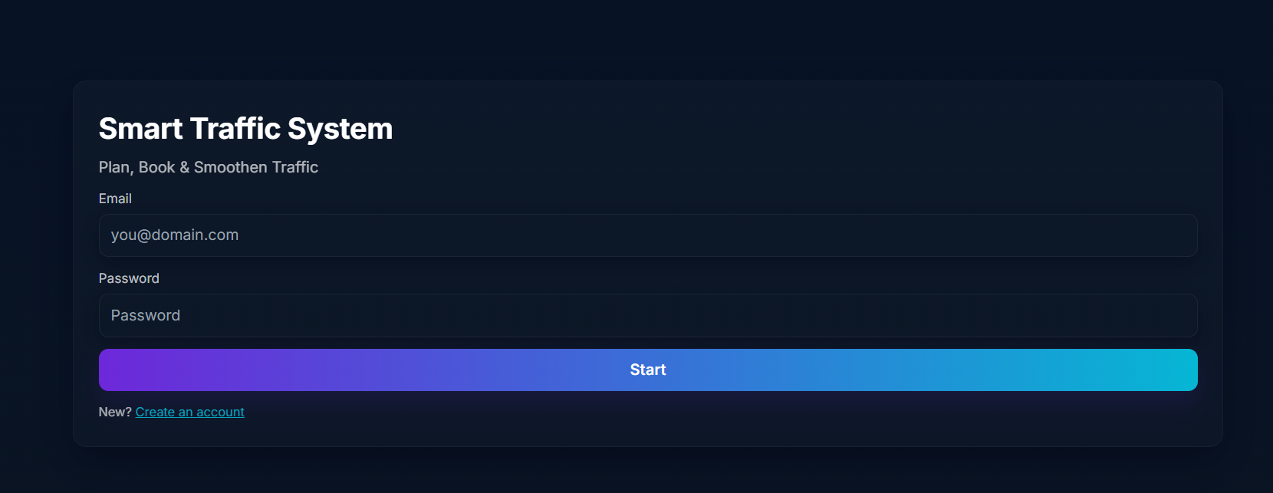
LOGIN

Slide 29
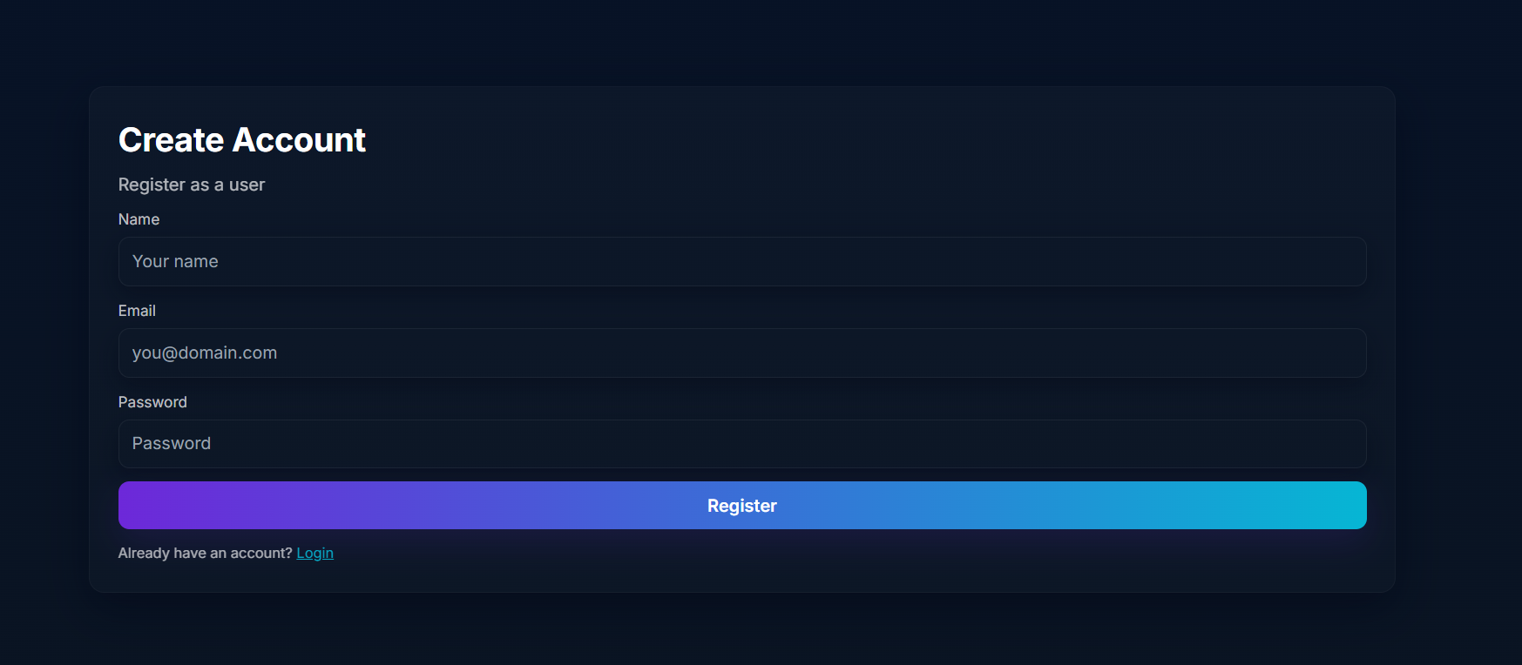
REGISTER

Slide 30
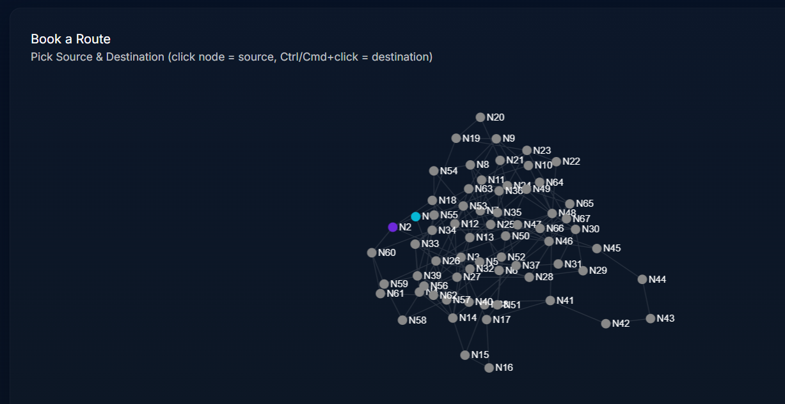
BOOKING

Slide 31
BOOKING

Slide 32
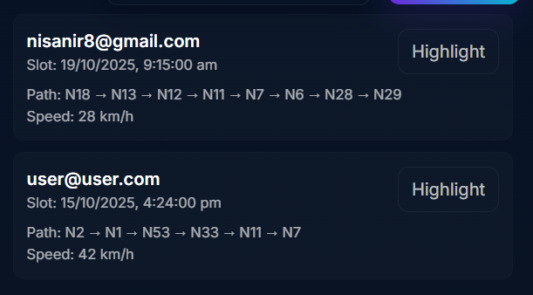
ADMIN DASHBOARD

Slide 33
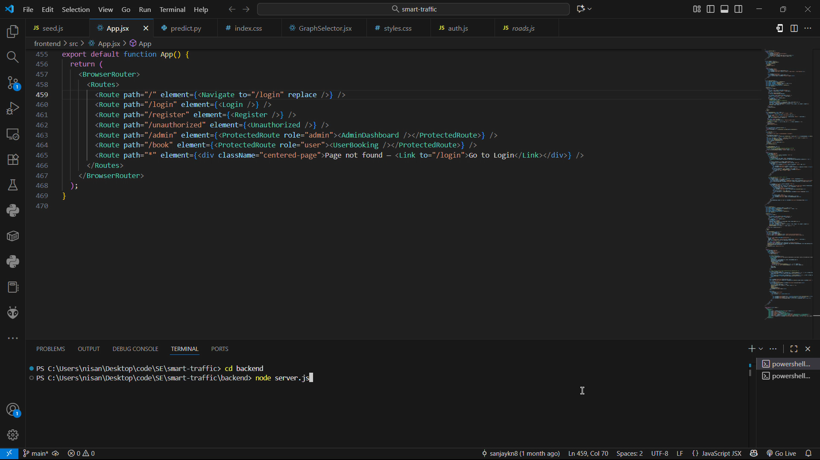

Slide 34
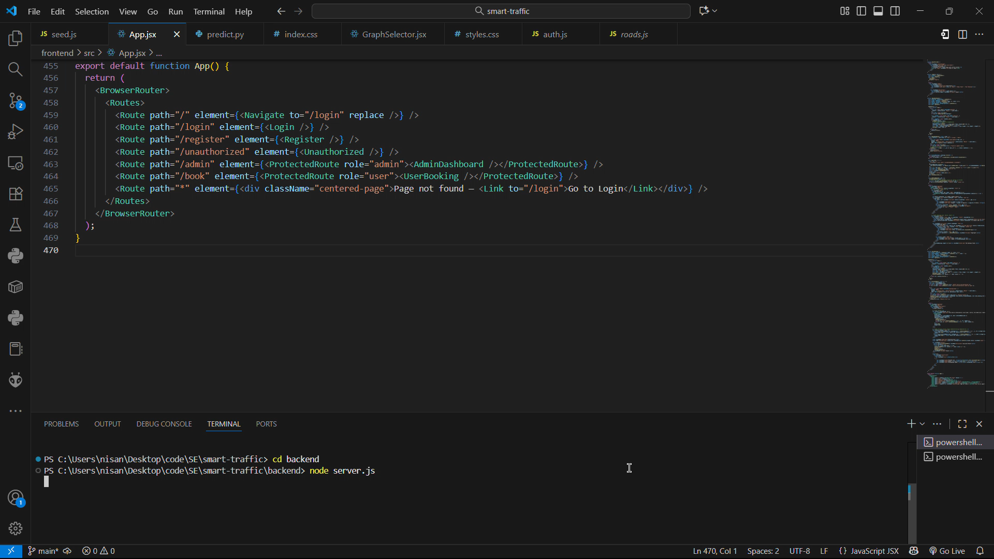

Slide 35
SOCIAL IMPACT
Positive impact: smoother traffic reduces idling and emissions, improves commute predictability and supports urban planning with recorded booking data
Ethical considerations: privacy (store minimal PII), fairness in slot allocation, transparency of ML recommendations
Governance suggestions: anonymized reporting, policies for slot distribution to avoid socioeconomic bias.
Department of Artificial Intelligence & Data Science
4 November 2025

Slide 36
CONCLUSION & FUTURE WORK
Summary: Smart Traffic Automation demonstrates a booking-driven approach to smooth traffic peaks using occupancy-aware routing and an ML predictor with a reliable fallback
Future work: scale ML to async microservice, integrate real map tiles (Leaflet), add WebSocket real-time updates, implement fairness and quota policies, add analytics dashboards
Code: https://github.com/sanjaykn8/SE_MiniProject
Department of Artificial Intelligence & Data Science
4 November 2025

Slide 37
THANK YOU

